Slide 1
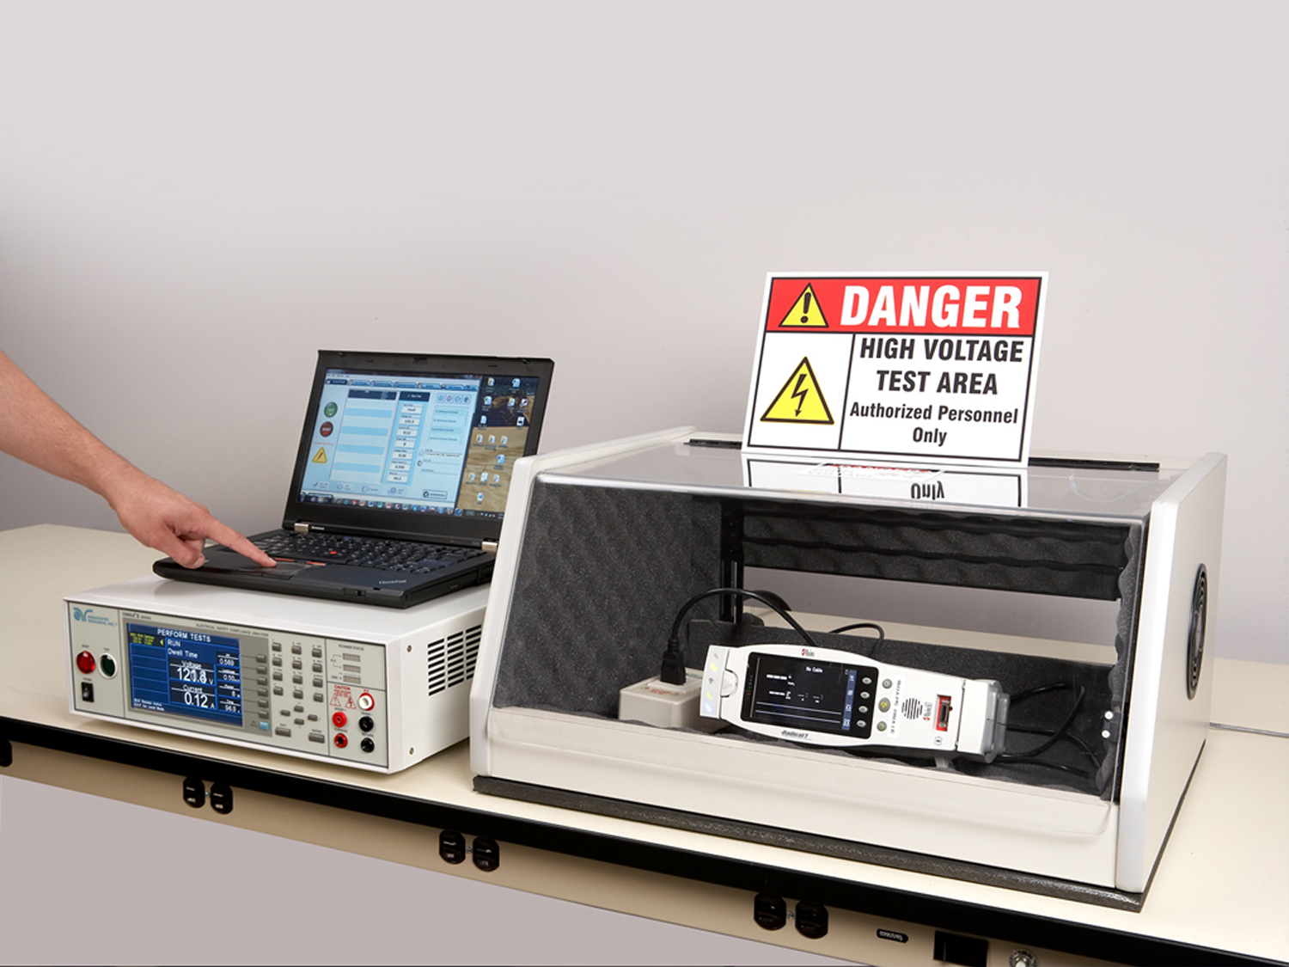
Hipot Testing 101

Slide 2
Meet Our Team
Syed Abidi
Bishan Patel
Allison Oba
Presenter
Applications Engineer
Panelist
Applications Engineer
Organizer
Marketing Assistant
Copyright 2016 Associated Research

Slide 3
Webinar Notes
Please use the Q & A utility to ask us any questions concerning
the material being presented.
Any questions related to running of the meeting (audio and
visual, etc) can be addressed to the host (Allison Oba) through
the chat line.
The Webinar is being recorded and will be available to view usually within a day on our website.
Please contact Allison Oba - chat line or email allison.oba@arisafety.com if you would like a copy of the presentation.

Slide 4
Quick Recap: EST Circuit Theory
During our previous webinar we covered:
Review of electrical safety tests
What part of the product is tested during each test
Electrical circuits for safety tests
Arc detection and SmartGFI circuits

Slide 5
Hipot Testing 101: Learning Objectives
Understanding the Hipot test
What is hipot test?
Hipot Test Requirements
Test Parameters
Hipot Test Considerations and Failures
Leakage Current and Dielectric Breakdown
What is tested?
Arc Detection

Slide 6
The Hipot Test
The Dielectric Voltage-Withstand Test is commonly known as the Hipot test.
Hipot test is the most common type of electrical safety test.
Designed to verify that the insulation of a product is adequate enough to withstand high voltage.
The test is performed by stressing the insulation of the product far beyond what it would encounter during normal use.
Hence, the term “voltage withstand test”.
The hipot test is performed at high voltage to test the insulation of a product.

Slide 7
The Hipot Test
The diagram shows a basic circuit used for hipot test.
It is a deliberate application of high voltage potential between the current carrying conductors and any exposed dead-metal.
The resulting leakage current is measured to determine whether a product’s insulation is able to withstand the high voltage without breaking down.
This test verifies that the insulation of a product is capable of protecting the user from any leakage currents as a result of an electrical fault within the product.
Leakage current is gives a measure of the product’s insulation quality.

Slide 8
The Hipot Test
Hipot test PASS condition.
The insulation is able to withstand the high voltage and does not break down or does not allow excess leakage current to flow on the surface of the product under test.
Quality insulation will not allow excess leakage current to flow on a product’s surface.

Slide 9
The Hipot Test
Hipot test FAIL condition.
Insulation breakdown results in excessive leakage to the chassis of the DUT.
Poor insulation will breakdown and dangerous leakage current can flow on the surface of a product.

Slide 10
The Hipot – A Versatile Test
When performed as Type tests Hipot tests are helpful in finding various important defects.
Nicked or crushed insulation, stray wire strands or braided shielding.
Conductive or corrosive contaminants around the conductors.
Terminal spacing problems and tolerance errors in cables.
Inadequate creepage and clearance distances introduced during the manufacturing process.

Slide 11
The Hipot – A Versatile Test
The production-line hipot test is used to determine whether the construction of a production unit is about the same as the construction of the unit that was subjected to type testing.
Some of the process failures that can be detected by a production-line hipot test include, for example, a transformer wound in such a way that creepage and clearance have been reduced.
Such a failure could result from a new operator in the winding department.
The hipot is more than just a go/no-go test. It can be used to find various insulation problems.

Slide 12
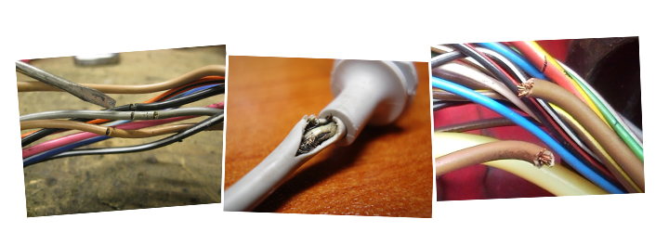
The Hipot – A Versatile Test
Scrapes • Pinholes • Spacing • Crimps • Heat
Material Build-up • Moisture
Insulation of any electrical device can become weak over time.

Slide 13
Video Demonstration

Slide 14
The Hipot Test
The best indication of a dielectric breakdown is a leakage current measurement significantly higher than the nominal current measurement.
Test voltage, the product being tested and the capacitance of the product can all impact the total leakage current measurement.
When we perform a hipot test on a product, we can think of the product as a giant capacitor.
The voltage is applied between the mains input and the chassis of the product which are separated by the insulation, which is just like a capacitor.

Slide 15
Test Voltages
Unless and otherwise stated by the safety standard, a good rule of thumb to calculate the hipot test voltage is: (2 X Nominal Input Voltage) + 1000V
For example, the hipot test voltage for a product that has a nominal operating voltage of 120V will be: (2 X 120V) + 1000V = 240V + 1000V = 1240V or 1.24KV.
In some cases, safety agency requirements call out for hipot test voltage for certain devices.
For example, medical equipment with applied parts that have direct contact with a patient is tested at 4000V or 4KV.
Most double insulated (Class II) products are subjected to design tests at voltage levels much higher than the rule of thumb described above.
Hipot test parameters are called out by the standards but when in doubt, use the rule of thumb.

Slide 16
Class I vs. Class II Application

Slide 17
Class I vs. Class II Application

Slide 18
Class I vs. Class II Application

Slide 19
Class I vs. Class II Application

Slide 20
By the Numbers - Standards

Slide 21
Production Hipot test parameters may differ from Type test parameters.

Slide 23
Poll Question 1
Are you required to perform both Type and Production Line Hipot Tests?

Slide 24
Video Demonstration

Slide 25
Failure Detectors
Breakdown
400μsec interrupt
Shorts and Breakdowns
Leakage Limits
Leakage high and low limits
100msec samples
Arc Detection
Arc Failure
Arc detection must be turned ON
Each failure detector has a priority on the instrument. Shorts and breakdowns will always be detected with a high speed interrupt. Leakage limits will trigger a failure if leakage current strays from user set values. Arc detection is a extra feature which is enabled.

Slide 26
Failure Detection
HV
DUT
R
R
L
RTN
high
frequency
ARC
high speed
low
frequency
slower
LEAKAGE
CPU
(meter)
10
samples/sec
both frequencies,
but one threshold
OVERLOAD
high speed

Slide 27
Arc Failure Detector
>10KHz
comparator
High
Pass
Filter
+
-
CPU
interrupt
400µS
Keys
1 - 9
D/A
Sensitivity
Level
Adjustment

Slide 28
Arc Detection Settings
Arc Setting | mA Trip Level
1 | 20
2 | 17.75
3 | 15.5
4 | 13.25
5 | 11
6 | 8.75
7 | 6.5
8 | 4.25
9 | 2
It’s important to remember that this method of arc detection is NOT an exact science. There are many variables involved including surface geometry, altitude, atmospheric pressure etc.

Slide 29
Poll Question 2
When a product fails a Hipot test, what do you do next?

Slide 30
Video Demonstration

Slide 31
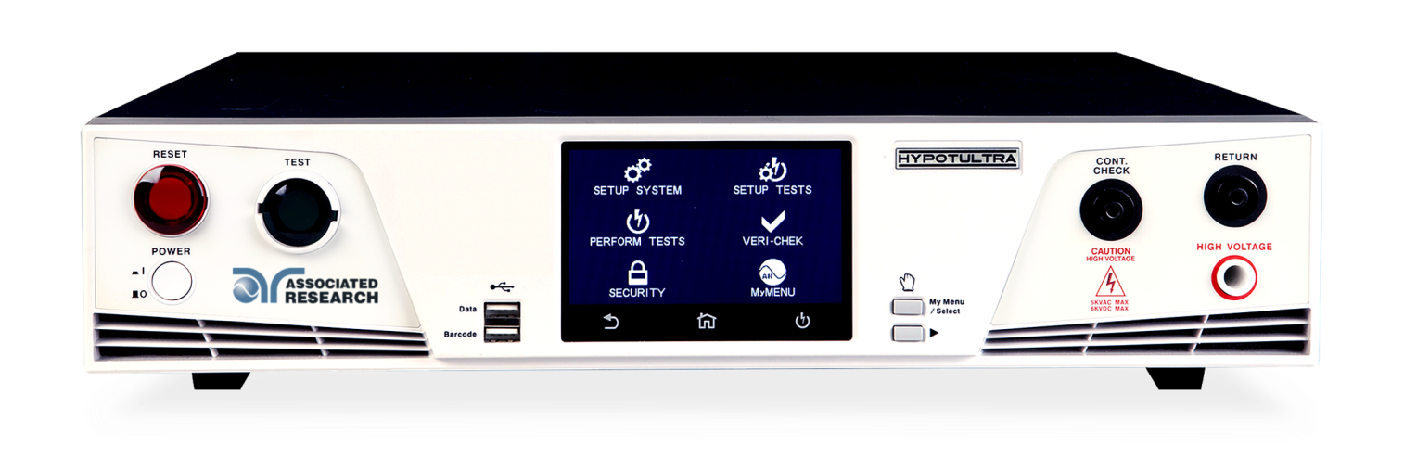
Contact Us
If you would like a copy of this presentation please contact Allison Oba at allison.oba@arisafety.com
Check out our website for more information arisafety.com
Follow Us!
Associated Research, Inc.
@ARHypot

