Slide 1
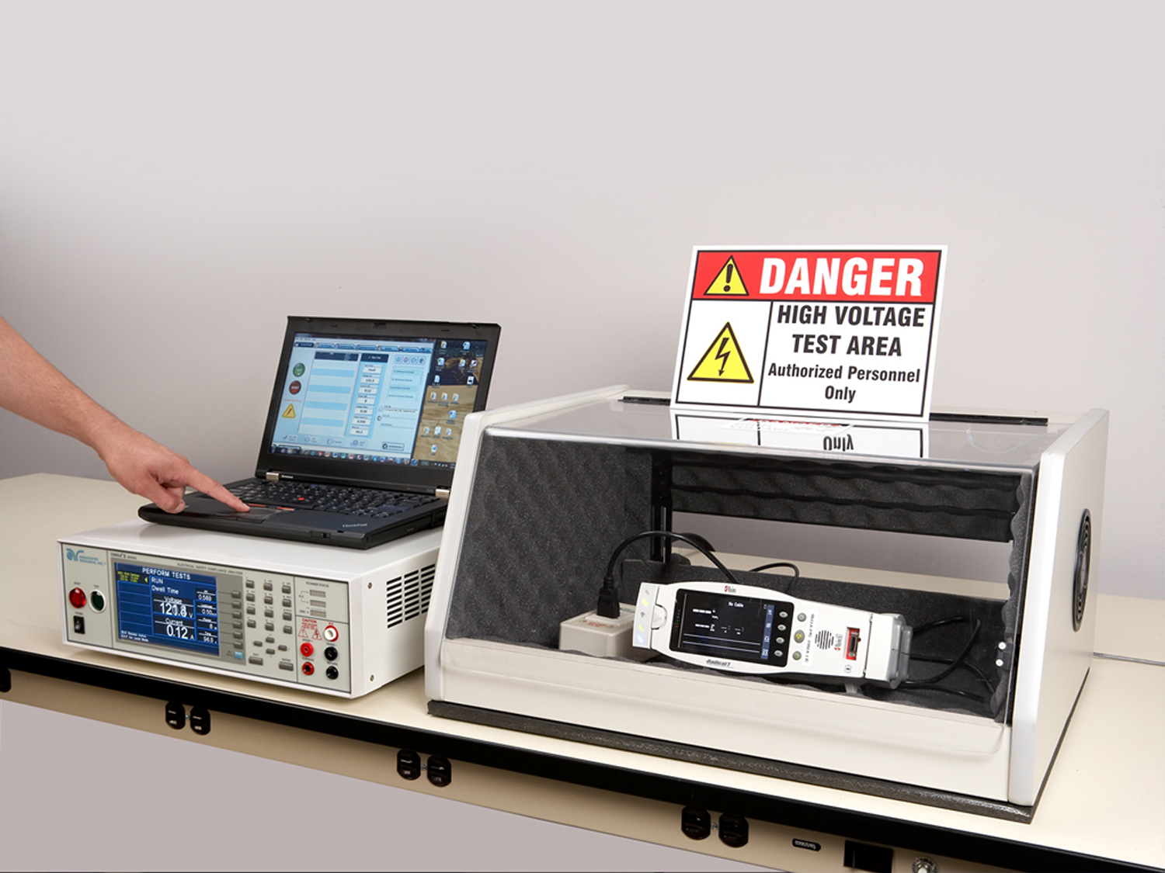
Hipot Testing 102

Slide 2
Meet Our Team
Bishan Patel
Anthony Arroyo
Allison Oba
Presenter
Applications Engineer
Panelist
Applications Engineer
Organizer
Marketing Assistant
Copyright 2016 Associated Research

Slide 3
Webinar Notes
Please use the Q & A utility to ask us any questions concerning
the material being presented.
Any questions related to running of the meeting (audio and
visual, etc) can be addressed to the host (Allison Oba) through
the chat line.
The Webinar is being recorded and will be available to view usually within a day on our website.
Please contact Allison Oba - chat line or email allison.oba@arisafety.com if you would like a copy of the presentation.

Slide 4
Quick Recap: Hipot Testing 101
During our previous webinar we covered:
Understanding Hipot test
Hipot test requirements
Hipot test considerations and failures
Leakage Current, Dielectric Breakdown and Arc Detection

Slide 5
Hipot Testing 102: Learning Objectives
AC vs DC Testing
Reactive vs. Real Current
500 VA Hipot Testing
What is 500VA Testing?
Hipot Instrument Features
SmartGFI, Interlock & Prompt and Hold
Pros. and Cons.
Ramp-Hi and Charge-Lo
Line vs. Load Regulation

Slide 6
Review Question
What is the AC Hipot test voltage for a 240 V input rated Device Under Test (DUT)?

Slide 7
AC vs. DC Hipot Testing
Depending on the product being tested and the test standard, the hipot test can either be performed using AC or DC potential.
Both AC and DC hipot tests have inherent advantages and disadvantages which are evident depending on the product being tested.
It is important to understand the difference between the nature of AC and DC voltage/current.
AC or DC
Differences
Which to use?

Slide 8
AC vs. DC Hipot Testing
AC Hipot
DC Hipot

Slide 9
Poll Question 1
What type of Hipot test do you perform?

Slide 10
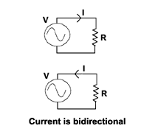
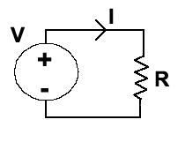
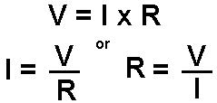
Ohm’s Law
The behavior of AC and DC current varies in a resistive and capacitive circuit.
AC current is bi-directional in nature whereas DC current flows in one direction.
The relationship between current, voltage and resistance is defined by the famous OHM’s LAW
OHM’s Law governs the relationship between current, voltage and resistance

Slide 11
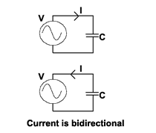
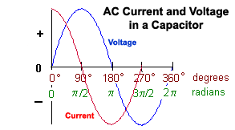
The AC Hipot Test – Reactive Current
When an AC potential is applied across a resistor, the resulting leakage current is in phase with the applied voltage.
When an AC potential is applied across a capacitor, the resulting leakage current that flows is 90° out of phase with the applied voltage.
This is the reactive current due to the capacitor.
AC current through a resistor is bi-directional.

Slide 12
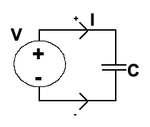
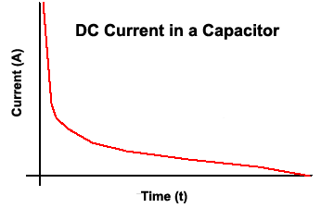
The DC Hipot Test – Charging Current
In a capacitive circuit, the AC and DC currents behave differently.
When a DC potential is applied across a capacitor, large amount of current is required to charge the capacitor.
As the capacitor charges up with time, the current decreases and point comes where the capacitor is fully charged and no current flows.
Current in a capacitor goes to zero when fully charged.

Slide 13
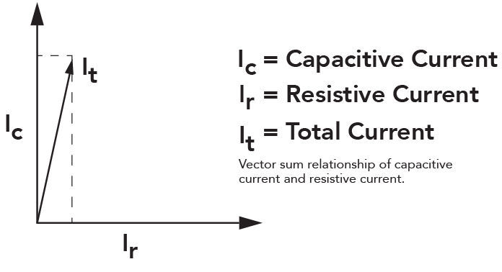
Total Leakage Current
The leakage current that is measured by most AC hipot testers is the vector sum of the resistive leakage current and the reactive leakage current.
Some Associated Research hipot testers are capable of displaying real and total leakage current for manufacturers who require extra information.
Vector Sum Relationship
The hipot is more than just a go/no-go test. It can be used to find various insulation problems.

Slide 14
AC vs. DC
AC HIPOT ADVANTAGES | DC HIPOT ADVANTAGES
No ramping of voltage required due to the changing polarity of the AC voltage | Can be performed at a much lower current level with less risk to the operator
Discharging the DUT is not necessary | Often easier to perform on capacitive DUT’s
Insulation is stressed in both polarities | Leakage current measurement is purely real
Measures both real and reactive current | Cost effective
Commonly accepted by safety agencies | Not always accepted by safety agencies

Slide 15
Video Demonstration

Slide 16
500 VA Hipot Testing
VA Rating - Certain standards require the use of a 500VA hipot transformer
Energy and Breakdown - Originally this was required to ensure hipot voltage output remained constant under varying line and load conditions
High Leakage Applications - Higher mA output may also be required for high leakage currents. For example, a 2000m length of cable may have 60mA of leakage.
Most Associated Research instruments have a 5000V output. Thus, the instruments have a 100mA trip current rating and 200mA short circuit current rating.

Slide 17
500 VA Hipot Testing – By the Standards
Standard | Description | Hipot Requirements
IEC 61010-1 | Equipment for Measurement, Control and Laboratory Use | The generator shall be able to supply a power of at least 500 VA. The test voltage is raised uniformly from 0 V to the specified value within 5 s and held at that value for at least the specified time.
IEC 60598-1 | Luminaires | A voltage of substantially sine-wave form, with a frequency of 50 Hz or 60 Hz and the value specified in Table 10.2, shall be applied for 1 min across the insulation shown in that table. Short circuit current shall be at least 200 mA. The overcurrent relay shall not trip when the output current is less than 100 mA.
IEC 60335-1 | Household Appliances | The insulation is subjected to a voltage of substantially sinusoidal waveform having a frequency of 50 Hz or 60 Hz for 1 min…No breakdown shall occur. Tests run at 4000V or less require 100mA trip limit and 200mA short circuit current.

Slide 18
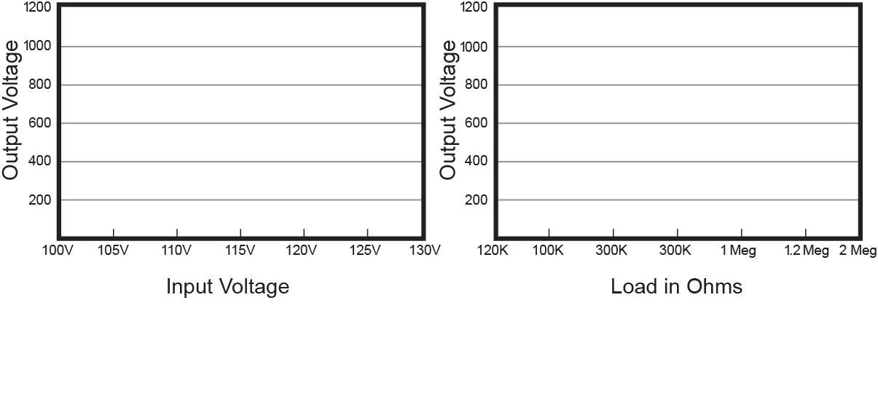
Line Vs. Load Regulation

Slide 19
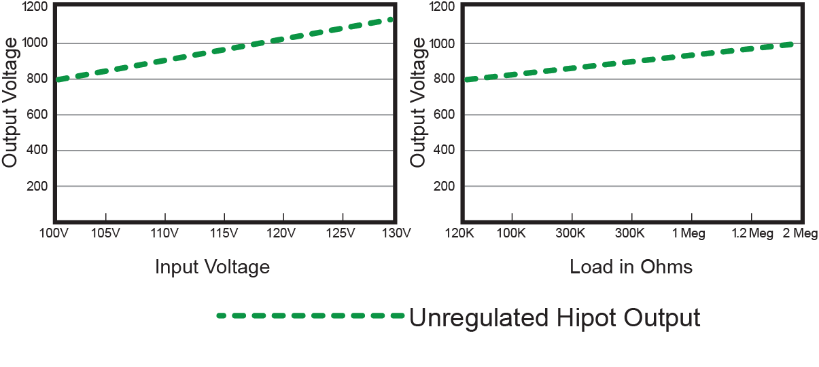
Line Vs. Load Regulation
If the hipot circuit is too heavily loaded or the input voltage drops, the hipot test voltage can dip causing an improper hipot test.

Slide 20
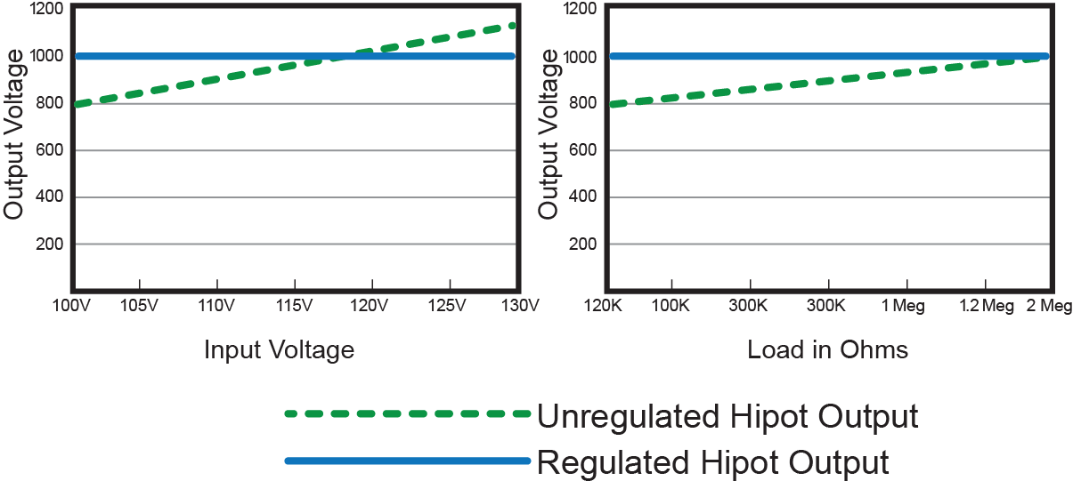
Line Vs. Load Regulation
If the hipot circuit is too heavily loaded or the input voltage drops, the hipot test voltage can dip causing an improper hipot test.

Slide 21
500 VA Hipot Testing
Some standards include exceptions to a 500VA hipot requirement
UL 1598 – Luminaires – Clause 19.20 :
“If the output of the test equipment is less than 500VA, the equipment shall include a voltmeter in the output circuit to directly indicate test potential.
Adoption of Exceptions
Keep your eyes open for new versions of standards – many of adding this exception to the 500VA requirement
In the end, you must follow what the standard states. However, your standard may contain an exception to the 500VA rule. Make sure you read the standard carefully.

Slide 22
Poll Question 2
Are you required to perform a 500 VA Hipot test?

Slide 23
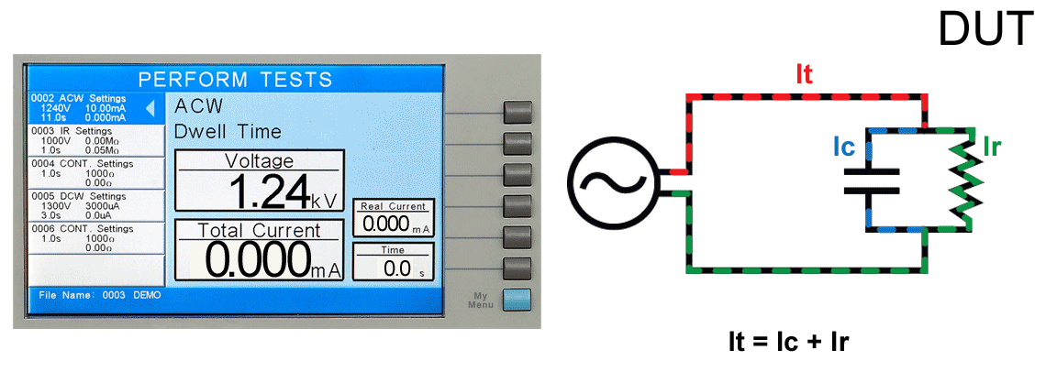
Leakage Current
Leakage current is the stray current that actually flows through the insulation. It is undesired current that we want to quantify to better understand the quality of an insulation barrier.

Slide 24
How to Set Leakage Current Limits?
Perform & Record
Perform hipot on known good products. Record all results
Calculate
Calculate the average leakage current value for these products
Add
Take 25% of this number and add to the average value. This is your Hi-Limit
Use that same 25% and subtract from the average value. This is your Lo-Limit
Subtract
Say I test 10 DUTs and calculate an average leakage current of 5.5mA. My limits would be:
Hi-Limit → (5.5mA)*0.25 = 1.375mA → 5.5mA + 1.375mA = 6.88mA
Lo-Limit → 5.5mA – 1.375mA = 4.13mA

Slide 25
Hipot Instrument Features

Slide 26
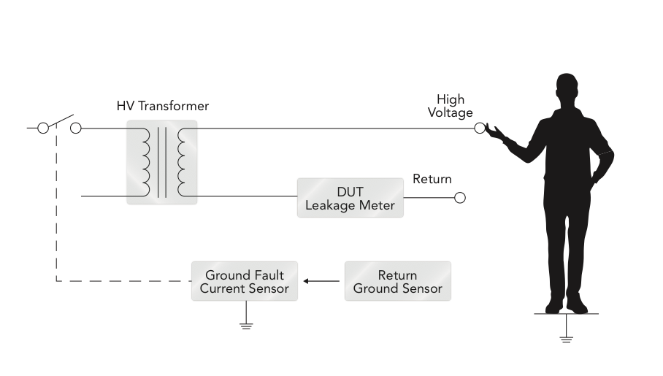
SmartGFI
Associated Research SmartGFI can detect when an operator is touching the DUT by monitoring returning leakage current. Standard units set to 450µA trip. OMNIA II series and the new HYPOTULTRA can be set from 400µA – 5mA.

Slide 27
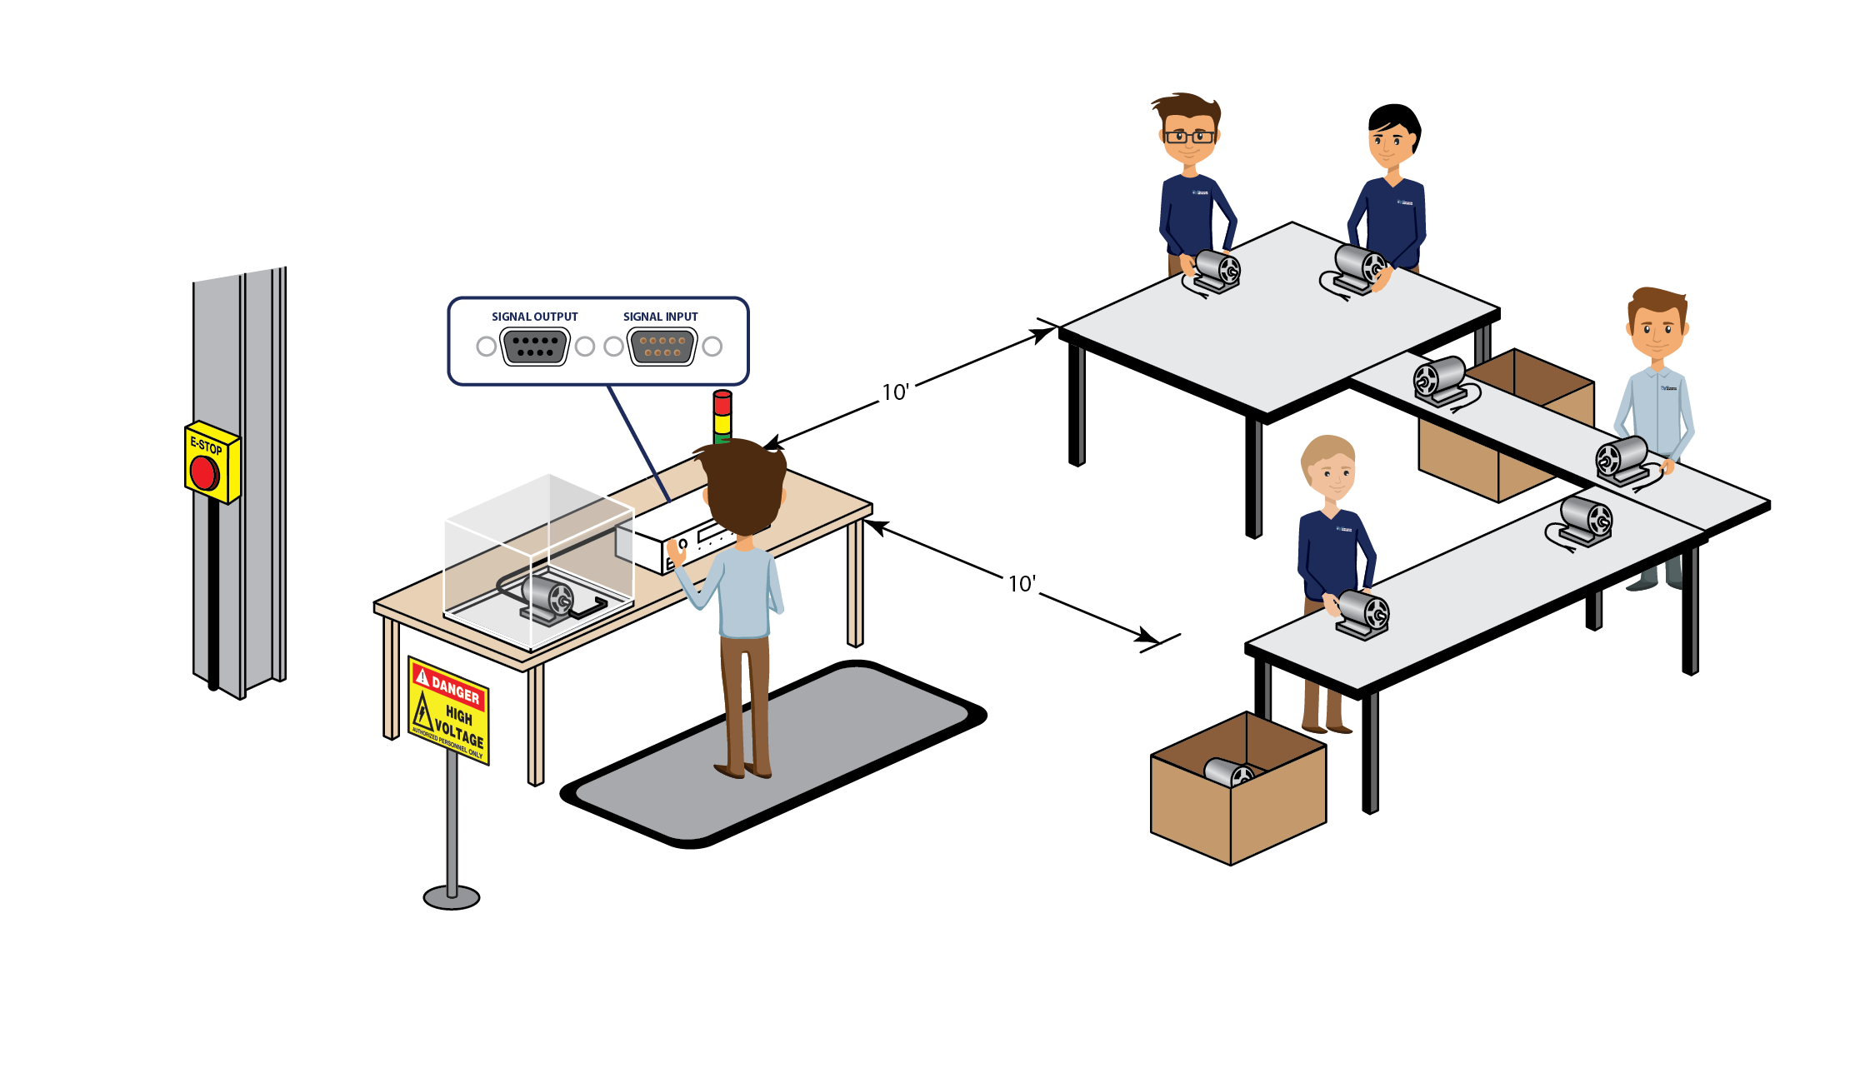
Interlock
Interlock located across pins 4 & 5 of Signal or Remote Input. Can be wired to DUT enclosure for an extra means of operator safety.

Slide 28
Prompt and Hold
User set prompt will hold the sequence until the operator presses TEST
The prompt allows the user to set instructions during the sequence. This could be used to convey a work instruction or for safety purposes.

Slide 29
Ramp HI and Charge-Lo
DC Hipot Test – At test start, there will be inrush current. Once the insulation is charged (full test potential), the leakage current drops off to near zero mA.
Ramp-Hi will ignore inrush current values so that the DC hipot does not falsely fail
Charge-Lo monitors hipot circuit with DUT attached. The Charge-Lo circuit takes half the inrush current value and substitutes as a low limit check.
These features are used with a DC hipot or IR test. Due to the nature of a DC withstand test, setting high and low leakage limits can prove difficult. These features compensate for this difficulty and allow the user to properly monitor the limits.

Slide 30
Video Demonstration

Slide 31
JOIN US FOR OUR NEXT WEBINAR
Wednesday, June 8th 10AM CST (GMT – 6:00) Testing Your Grounding Circuit: Bonding VS. Continuity
Click the link in chat box to learn more

Slide 32
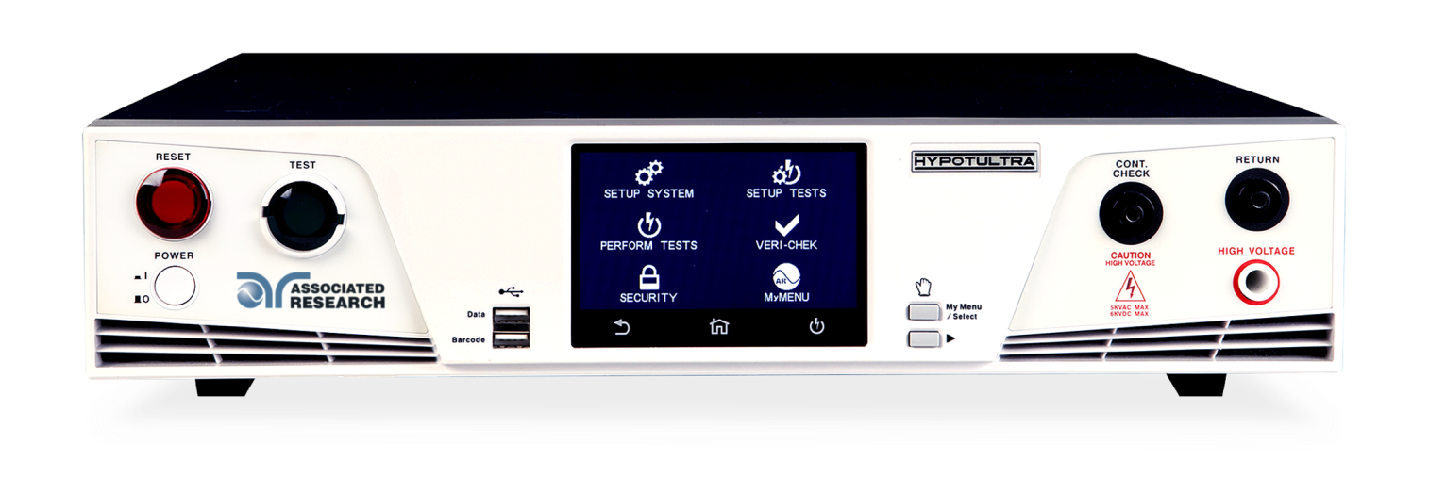
Contact Us
If you would like a copy of this presentation please contact Allison Oba at allison.oba@arisafety.com
Check out our website for more information arisafety.com
Follow Us!
Associated Research, Inc.
@ARHypot

